Slide 1

OAKLAND: #HellaPrivacy, #DeportICE History, Process, and Next Steps
July 2019
Brian Hofer
Executive Director, Secure Justice and Chair, City of Oakland’s Privacy Advisory Commission
Notes:
https://www.aclunc.org/blog/how-fight-stop-oaklands-domain-awareness-center-laid-groundwork-oakland-privacy-commission

Slide 2
(A true, mostly-good, yet unnecessarily-messy story about what can happen when a city government doesn’t think carefully about privacy from the outset.)

Slide 3
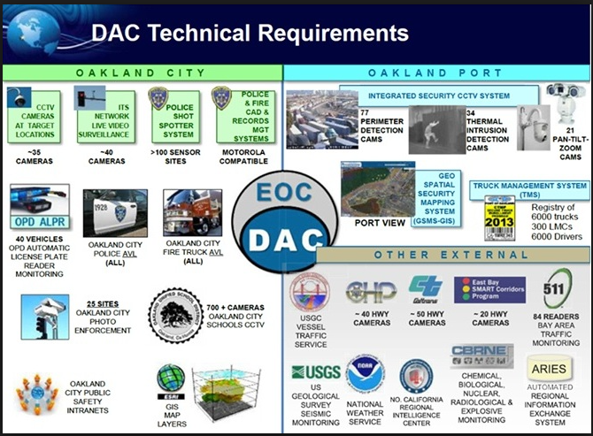
The Opportunity
Oakland contemplated building-out a multi-faceted surveillance apparatus
In 2014, Oakland was given the opportunity to expand its Port’s Domain Awareness Center
DHS would foot the $10.9M bill to build out a city-wide surveillance apparatus to fight terrorism and improve security
City council voted to proceed
Notes:
The Domain Awareness Center (DAC) was a planned central surveillance hub for law enforcement and emergency operations, aggregate and monitor video feeds and real-time data from a number of sources around Oakland, including closed-circuit video feeds (CCTV) from all over Oakland, 700 cameras at Oakland public schools, 135 cameras at the Oakland Coliseum complex, license plate recognition feeds, thermal imaging and body movement recognition, possibly facial recognition cameras, and more.
Funded by grants from the Department of Homeland Security (DHS), and implemented by the military contractor Science Applications International Corporation (SAIC).

Slide 4
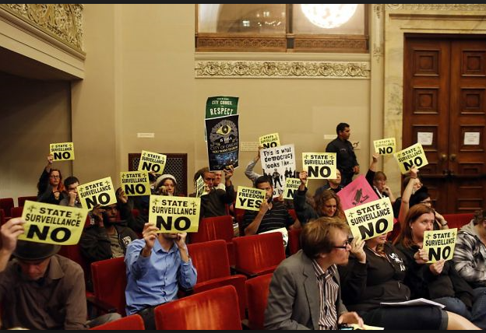

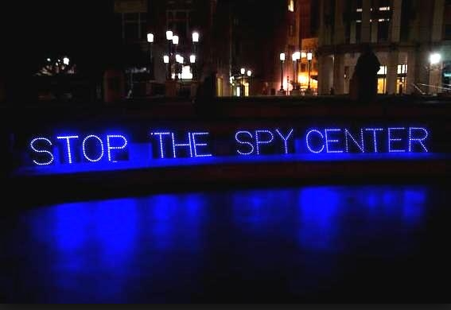
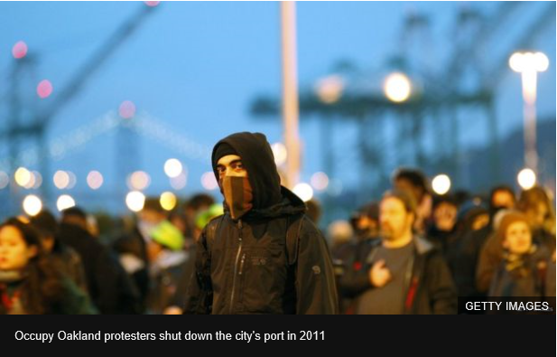
Community Response
Community backlash was swift and certain
Prompted Oakland residents to organize, protest, and to publically assert a three-part right to privacy:
Secrecy - our ability to keep our opinions known only to those we intend to receive them. Without secrecy, people may not discuss affairs with whom they choose, excluding those with whom they do not wish to converse;
Anonymity - Secrecy about who is sending and receiving an opinion or message; and
Autonomy - Ability to make our own life decisions free from any force that has violated our secrecy or anonymity.
Notes:
--led to the formation of Oakland Privacy as a branch of Occupy Oakland – the Oakland Privacy Working Group,
--rallies and marches against the DAC and other surveillance technologies being acquired by Bay Area cities,
--began working with the ACLU and to testify at City Council meetings.
--publically asserted the right of Oakland residents to freedom fro state surveillance, and particularly to the rights to Secrecy, Anonymity, and Autonomy
* Oakland City Council Resolution 85638, June 2, 1015, DAC Privacy and Data Retention Policy designed to promoted a “Presumption of Privacy.”
nomy.

Slide 5
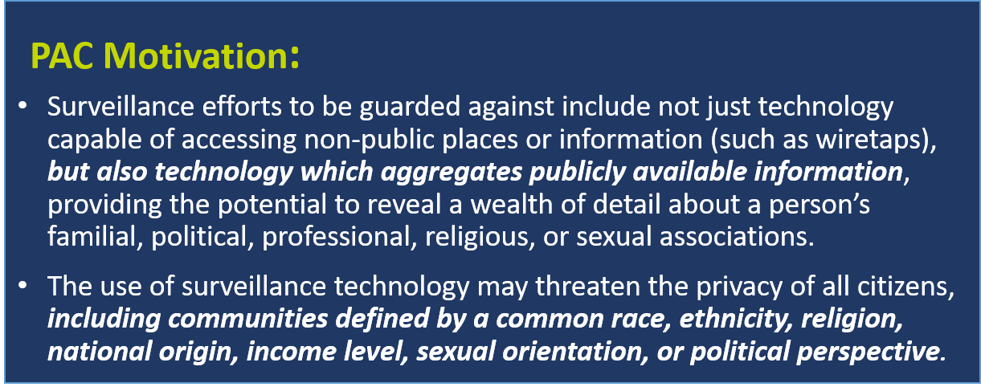
Oakland’s Reaction?
The City Council listened to residents
Resolution No.85638 C.M.S. on June 2, 2015
Voted to restrict DAC to a Port-focused operation, removing citywide traffic cameras and ShotSpotter maps from the system;
Established an ad hoc Privacy Advisory Committee to develop a DAC Privacy and Data Retention Policy; and
Created a permanent Privacy Advisory Commission to provide advice to the City of Oakland on best practices to protect Oaklanders' privacy rights in connection with the City's purchase and use of surveillance equipment and other technology that collects or stores our data
Volunteer commissioners from each city council district:
District 1 Reem Suleiman
District 2 Chloe Brown
District 3 Brian Hofer (Chair)
District 4 Lou Katz
District 5 Raymundo Jacquez III
District 6 Gina Tomlinson
District 7 Robert T. Oliver
At Large Henry Gage III
Mayoral Heather Patterson
Notes:
Positive response!

Slide 6
Privacy Advisory Commission
Duties of the Commission
Resolution No.85638 C.M.S. on June 2, 2015
Provide advice and technical assistance to the City of Oakland on best practices to protect citizen privacy rights in connection with the City’s purchase and use of surveillance equipment and other technology that collects or stores citizen data.
Draft for City Council consideration, model legislation relevant to privacy and data protection, including a Surveillance Equipment Usage Ordinance.
Submit annual reports and recommendations to the City Council regarding: (1) the City’s use of surveillance equipment, and (2) whether new City surveillance equipment privacy and data retention policies should be developed or such existing policies be amended.
Provide analyses to the City Council of pending federal, state and local legislation relevant to the City’s purchase and/or use of technology that collects, stores, transmits, handles or processes citizen data.
Conduct public hearings, make reports, findings and recommendations either to the City Administrator or the City Council as appropriate, including an annual report to be presented in writing to the City Council.
Review and make recommendations to the City Council regarding any proposed changes to the operations of the Domain Awareness Center (“DAC”) and/or proposed changes to the City’s Policy for Privacy and Data Retention for the Port Domain Awareness Center (“DAC Policy”).

Slide 7
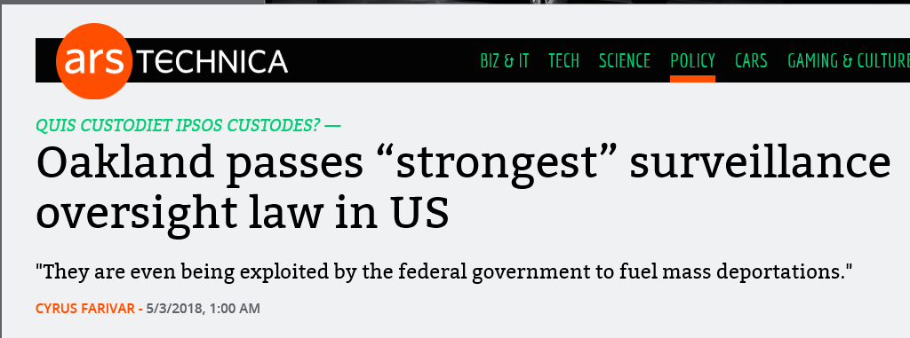

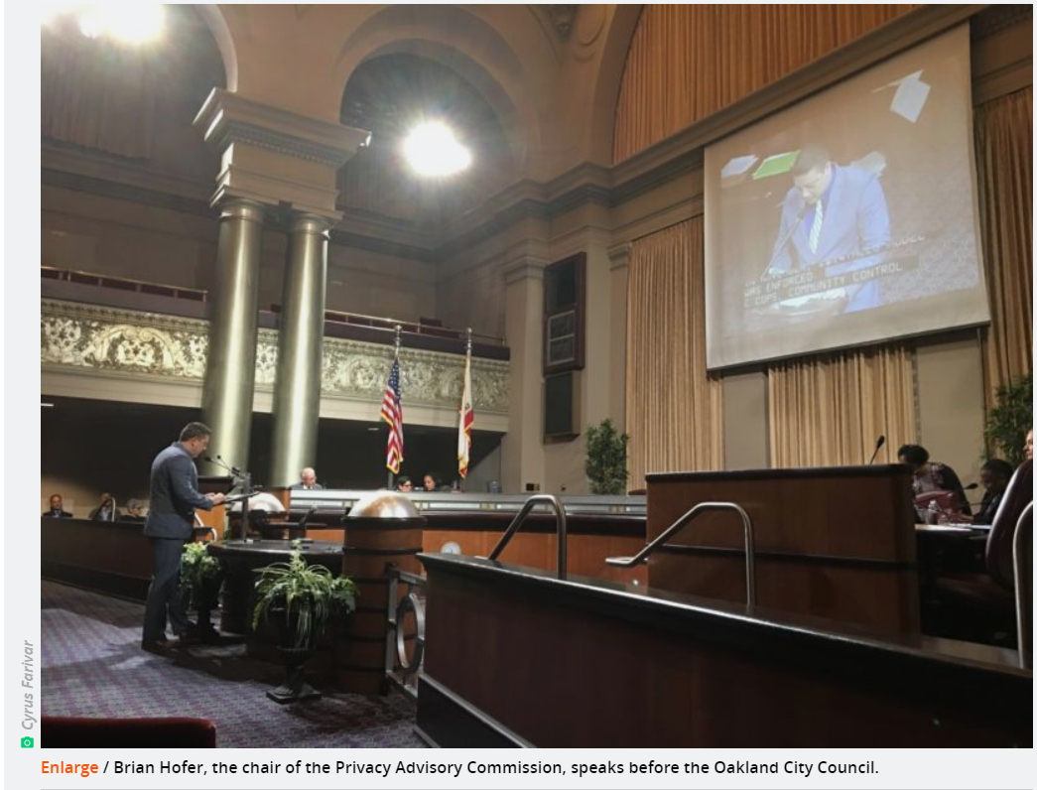
Surveillance and Community Safety Ordinance
“Surveillance Ordinance” passed May 2018
Ordinance adding Ch. 9.64 to the Municipal Code Establishing Rules For the City’s Acquisition and Use of Surveillance Tech
Purpose: Establish a public approval process for surveillance technologies used by the city; lay the groundwork for the City Council to decide whether the benefits of using the technology outweigh the costs to privacy.
City obligations: City agencies must submit a “technology impact report” and a use policy to Oakland’s Privacy Advisory Commission if they plan to implement new surveillance technologies, like license plate readers or cellphone trackers.
“Surveillance Technologies”: Any software, electronic device, system utilizing an electronic device, or similar used, designed, or primarily intended to collect, retain, analyze, process, or share audio, electronic, visual, location, thermal, olfactory, biometric, or similar information specifically associated with, or capable of being associated with, any individual or group.
Differentiated from other cities: 1) Standardized public format for evaluation and approval; 2) Prohibits secret contracts or non-disclosure agreements between cities and third parties; 3) Provides whistleblower protections to employees who report violations.
Notes:
Does not include routine office hardware (tv, computers, credit card machines, badge readers, copy machines), parking ticket devices, handheld digital cameras, police department interview room cameras, medical equipment used to diagnose or treat injuries, city databases used for payroll, accounting, or other fiscal databases, etc.

Slide 8
How does the Surveillance Ordinance work in practice?
Process for city to acquire or use a surveillance technology
Notification
Report Submission
PAC Evaluation
Public Notice
Public Hearing
City entity notifies PAC Chair of its wish to acquire new surveillance technology.
City entity submits a Surveillance Impact Report and proposed Surveillance Use Policy to the Privacy Advisory Commission for its review at a regularly noticed meeting.
PAC reviews documentation, works with City entity to revise Impact Report and Use Policy
Recommends that the City Council adopt, modify, or reject the proposed Surveillance Use Policy.
City Council provides public notice that will include the Surveillance Impact Report, proposed Surveillance Use Policy, and Privacy Advisory Commission recommendation at least fifteen (15) days prior to the public hearing.
City Council determination: 1) benefits to the community outweighs the costs; 2) proposal will safeguard civil liberties and civil rights; and 3) no alternative with a lesser economic cost or impact on civil rights or civil liberties would be as effective.

Slide 9
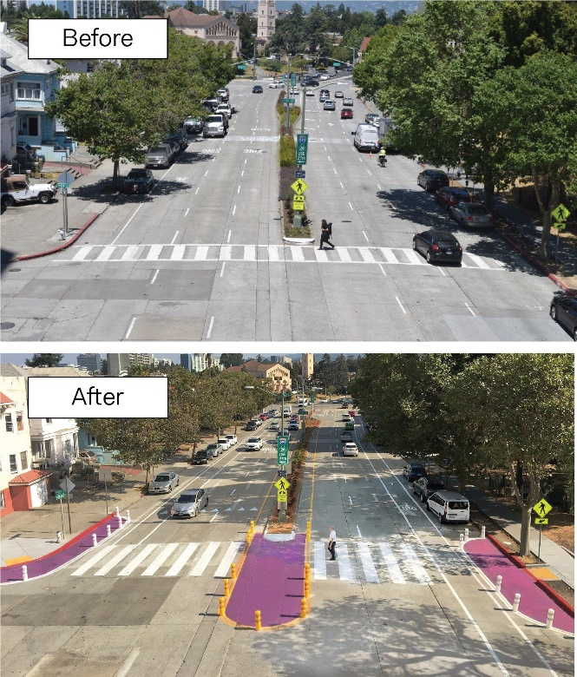
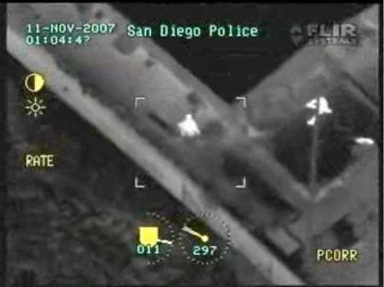
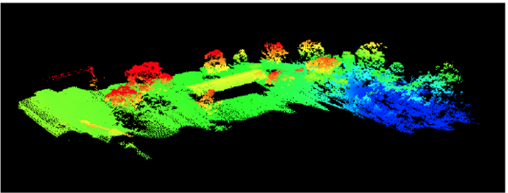
Illustrative Examples
Types of requests include:
E.g., Pending DOT request:
DOT acquisition of Unmanned Arial Vehicles (UAVs) to document transportation improvement projects;
DOT Parking and Mobility using vehicle-mounted Automatic License Plate Recognition (ALPR) to “virtually chalk” vehicles in time-limited spaces, verify permit parking, monitor “pay by phone” parking payments;
District Attorney’ use of surveillance video to monitor illegal dumping;
Police Dept. use of cell site simulators to locate missing persons and apprehend fugitives;
. . .
Data types and sources: Optical cameras, IR cameras, LIDAR, mapping software
Potential impacts: Capturing PII without notice or consent; Enabling targeted voyeurism; Data use and retention uncertainties
Mitigations: Deploy only in public and with notice where possible; obfuscate faces and license plates. Two-person team; focus must remain on project

Slide 10
Elements of the Required Documents
(Heart of the ordinance)
Surveillance Impact Report:
Surveillance Use Policy:
Description of the technology
Proposed use(s)
Location to be deployed
Impact on civil rights and liberties
Mitigations
Data types and sources
Data security
Fiscal cost(s)
Third-party dependence
Alternative methods
Track record
Purpose of the use
Authorized use(s)
Data collection
Data access
Data protection
Data retention
Public access
Third party data sharing
Training
Auditing and Oversight
Maintenance

Slide 11
Challenges We Face
Many positive aspects of a volunteer, resident-driven effort. But also some challenges.
PAC is a volunteer task-force
Varied orientations, experiences, and expertise
Meet monthly for 2 hours
Reliance on city employees to identify and disclose broader social impacts
City employees bear the burden of conducting front-line investigations
City employees are new to the process of investigating technology and assessing privacy risks
They lack the time, experience, and fiscal resources to conduct deep investigations
Privacy is cultural and contextual
PAC evaluators need to ensure we have enough information to make good decisions---often this means conducting independent research
“Privacy” impact assessments may not adequately capture social impacts of surveillance on historically disenfranchised communities –
Scalability and predictability
As cities continue to adopt new technologies, the PAC will not always be able to assist closely with the development of each PIAs and Use Cases

Slide 12
How We’re Addressing These Challenges
(1) Surveillance Technology Assessment Questionnaire (STAQ) Database
Goal: Work collaboratively with other cities, universities, and civil society to share insights and develop a common set of knowledge resources
What it is: An online information management system for city staff to document and share social impacts of new surveillance technologies. The tool will guide city employees step-by-step through questions about how technologies work, how they will be implemented, for what purpose(s), and their risks and benefits to members of the public.
What it does (our vision) – KNOWLEGE CREATION and SHARING
Allow city employees and others to search privacy impact assessments already conducted by other cities, by department, technology type, and use case to be used as guidance documents for a given implementation;
Access expert knowledge about known technology risks and benefits provided by civil society, privacy and social justice researchers and experts; and
Contribute analyses and lessons learned
How it will help (our vision) – CONSISTENCEY and TRANSPARENCY
Provide city employees with a uniform interface and framework to assist them in understanding technology capabilities, benefits, and risks;
Allows for documentation and sharing of information for ongoing evaluation of accuracy and fairness;
Gives civil society, regulators, journalists, and city residents insight into the technologies used in particular cities, enabling public dialog about tradeoffs between privacy, civil liberties and safety.
Notes:
an online information management system for city staff to document and share social impacts of new surveillance technologies

Slide 13
Creating a Multi-stakeholder Open STAQ
Projected project timeline (Phase 1)
November 2018
December 2018
Document requested system requirements, features
February 2019
January 2019
Schedule and conduct consultative interviews
Identify stakeholders and subject matter experts
Present findings and elicit feedback from stakeholders in city government, communities, civil society, and industry
March 2019
Create a working prototype sufficient to present to stakeholders
Evaluate feedback and prepare mid-term report;
Proceed to Phase II
Assess financial costs, time requirements, and personnel
Phase 2
Incorporate feedback into working model
Solicit funding as needed for beta development
Begin beta deployment

Slide 14


How We’re Addressing These Challenges
(2) Researching Privacy Principles
Enterprise-wide
IOT-specific
In Fall 2017, San Jose engaged the CyberLaw Clinic at Harvard Law School
High-level, but designed with the context-specific attributes of IoT programs in mind
For large cities, fewer practical challenges than Enterprise-wide approach
Example: New York City
General in nature
Cuts across all city departments and all collection and use of data by the city
Intended to act as a “north star” or guidepost for many years of technological change
Example: Seattle
Found that municipal approaches to privacy fit into one of four models:
Iterative or “Playbook”
National Legislation
Desire to avoid “policy lock-in” and adapt approach as new technologies develop
Broad principles might stifle innovation for fear of violating policy
Examples: Austin, Boston, Philadelphia, Pittsburgh
Central to many international privacy regimes, especially in Europe
Privacy principles are legally required to comply with enacted legislation
Examples: Stockholm, London
Notes:
--This is not to discuss or champion the specific findings of the Harvard CyberLaw clinic, but just to note that analyses are being done as cities try to find the path that is right for their needs
--Purpose of the principles? “Tone from the top – express and socialize the philosophy of the city”? High-level guidance for edge-cases? How to operationalize the principles into practices.

Slide 15
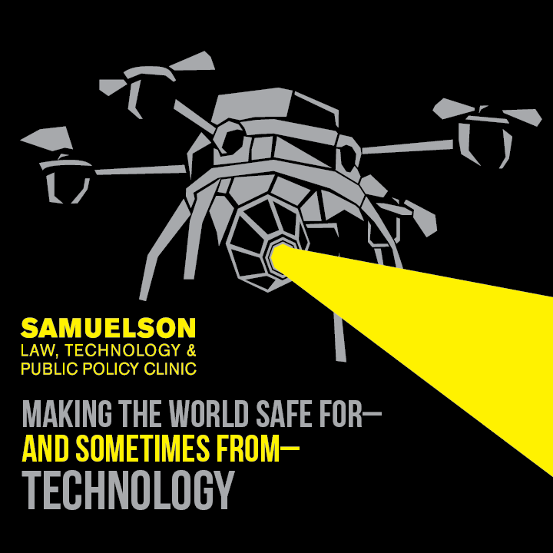
(2) Researching Privacy Principles

Slide 16
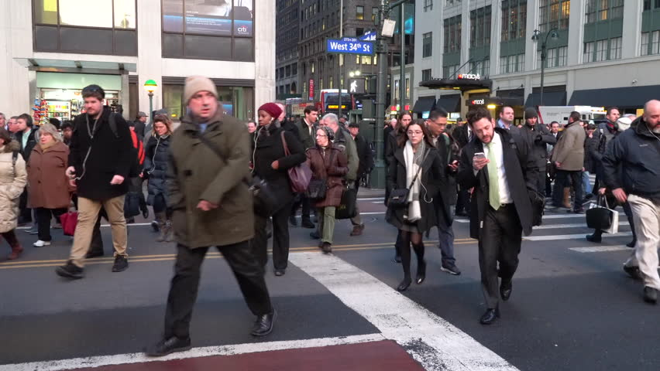

How We’re Addressing These Challenges
(3) Communicating with technology companies to assess opportunities for protecting privacy
A variety of interesting solutions, depending on use case:
Data de-identification
Differential privacy
Selective sharing of data across silos while assuring confidentiality and privacy
Tools to enable data obfuscation
Pictures Collected by an AI system before and after applying facial blur policies
Notes:
bias detection and remediation (rebalance datasets); computer vision techniques to blur faces

Slide 17
TL:DR Five Years of Bay Area Privacy Coalition Work
Defeated $12MM city-wide surveillance network – Domain Awareness Center (2014)
Creation of first municipal citizen’s commission with oversight of surveillance equipment/use (2015)
Defeated PredPol funding request during budget review (2015)
Created nation’s strongest Stingray policy with first annual report - Alameda County (2015)
Stopped BART’s implementation of ALPR, led to invite from the Board to draft surveillance equipment ordinance (2016)
Adoption of first-of-its-kind surveillance equipment ordinance - Santa Clara County (2016)
Created new gold standard Stingray policy with most robust annual report - Oakland (2016)
Pre-policy - no notice, no warrant, average annual use: 35
Post-policy - each use is noticed, warrant, 2017 use: 3, homicides
Oakland terminates task force MOU with ICE/HSI (2017)
Oakland enacts “TrumpIntelPro” ordinance (2017)
Creation of nation’s first true “non-cooperation” Sanctuary City Ordinance - Oakland (2018)
Rejection of ALPR contract due to vendor Vigilant’s contract with ICE - Alameda city (2018)
Adoption of surveillance equipment ordinance, first city in the country - Berkeley (2018)
Adoption of surveillance equipment ordinance, second city in the country (two weeks after Berkeley) - Davis (2018)
Adoption of new gold standard surveillance equipment ordinance - Oakland (2018)
Prohibition on NDAs
Enhanced whistleblower protections
Most robust annual reporting metrics
Adoption of “Sanctuary Contracting Ordinance” - Richmond (2018)

Slide 18
Adoption of surveillance equipment ordinance, first transit district in the country – BART (2018)
Adoption of surveillance equipment ordinance – Palo Alto (2018)
Adoption of Sanctuary Contracting Ordinance – Oakland (2018)
Adoption of Sanctuary Contracting Ordinance – Berkeley (2018)
Adoption of surveillance equipment ordinance, first city in the nation to ban face surveillance – San Francisco (2019)
Adoption of amendment to ordinance, third city in the nation to ban face surveillance – Oakland (2019)

Slide 19
Show coalition sign on letter

Slide 20
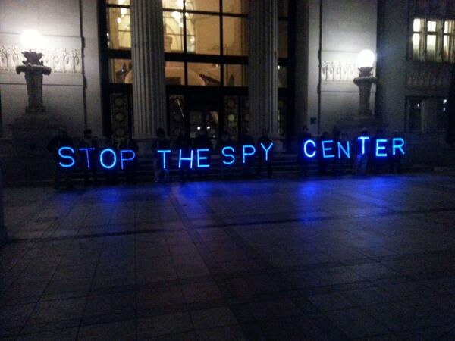
TrumpIntelPro, Sanctuary Contracting, and Surveillance Equipment Ordinances at minimum create friction and slow the advance of the surveillance/police state
Agenda watching and public record requests are underused, easy-to-do tools that have helped our success rate
A citizen's oversight commission gives you the platform, legitimacy, and voice to take back real community control
Coalition sign-on letters are magic and demonstrate the movement’s power
Talk to the ”other” side (administrative staff, law enforcement) – you might have more in common than you know
Don’t be afraid to speak to the elected officials doing the voting
Occupy Oakland Privacy Working group made this mistake in 2013, and went 0-2
Oakland Privacy (2014-to-present) has since been undefeated throughout the greater Bay Area.
#HellaPrivacy

Slide 21
Questions? Interested in engaging?
Please reach out! We’d love to hear from you.
brian@secure-justice.org
@b_haddy
@securejustice

